Slide 1

Computer Graphics
CS C 471 and IS C 471
Dr. Lucy J. Gudino
Computer Science & Information Systems Group
Birla Institute of Technology & Science, Pilani, Goa Campus

Slide 2
Solid Modeling
Methods:
  Extrusion
    build object with rotational or translational symmetries and others
    Objects are defined with a 2D primitive and a path in 3D space
  Constructive solid geometry (CSG)
  Boundary representation (B-rep)
  Spatial enumeration
  Instantiation.

Slide 3
Boundary representation (B-Rep)
an extension to the wireframe model
A solid is represented as a collection of connected surface elements, the boundary between solid and non-solid.
  Surfaces ➔ bounding surfaces.
  surface has its interior and exterior
  Normally a face is a bounded region of a planar, quadratic, toroidal, or sculptured surface.

Slide 4
Contd…
surface of a solid consists of a set of well organized faces
  faces may share vertices and edges that are curved segments

Slide 5
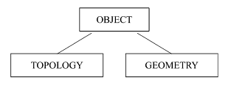
Boundary representation (B-Rep)
Two types of information:
  topological
  geometric
Topological Info:
  provide the relationships among vertices, edges and faces
  orientation of edges and faces
Geometric Info: Usually equations of the edges and faces

Slide 6
Contd…
Orientation of each face is very important
  a solid is represented as a closed space in 3-D space (surfaces connect without gaps)
  Ordering of vertices: CCW direction
  Right hand rule
  The boundary of a solid separates points inside from points outside the solid.
    Normal vectors
Notes:
to find exterior and interior face

Slide 7
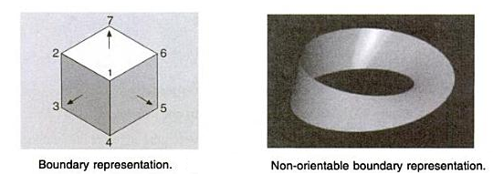
Notes:
Mobius band

Slide 8
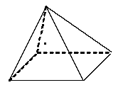
B-Rep data structure
B-Rep graph store face, edge and vertices as nodes, with pointers, or branches between the nodes to indicate connectivity.
v5
f3
f2
E3
E4
E1
v4
E7
f4
E2
v3
f5
E6
E8
f1
v1
v2
E5

Slide 9
B-Rep data structure
v5
f3
f2
E3
E4
E1
v4
E7
f4
E2
v3
solid
f5
E6
E8
f1
v1
E5
v2
face1 face2 face3 face4 face5
Combinatorial structure / topology
edge1 edge2 edge3 edge4 edge5 edge6 edge7 edge8
vertex1 vertex2 vertex3 vertex4 vertex5
Metric information/ geometry
(x, y, z)

Slide 10
Boundary representation- validity
System must validate topology of created solid.
B-Rep has to fulfill certain conditions to disallow self-intersecting and open objects
This condition include
  Each edge should adjoin exactly two faces and have a vertex at each end.
  Vertices are geometrically described by point coordinates

Slide 11
Boundary representation- validity
This condition include (cont)
  At least three edges must meet at each vertex.
  Faces are described by surface equations
  The set of faces forms a complete skin of the solid with no missing parts.
  Each face is bordered by an ordered set of edges forming a closed loop.
  Faces must only intersect at common edges or vertices.
  The boundaries of faces do not intersect themselves

Slide 12
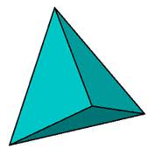
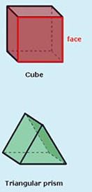
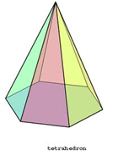
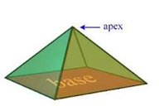

Slide 13
Boundary representation- validity
Validity also checked through mathematical evaluation
  Evaluation is based upon Euler’s Law (valid for simple polyhedra – no hole)
  V – E + F = 2 V-vertices E- edges F- face loops
v5
V = 5, E = 8, F = 5
5 – 8 + 5 = 2
f3
f2
E3
E4
E1
v4
E7
f4
E2
v3
f5
E6
E8
f1
v1
E5
v2

Slide 14
Boundary representation- validity
Expanded Euler’s law for complex polyhedrons (with holes)
Euler-Poincare Law:
  V-E+F-H=2(B-P)
  H – number of holes in face, P- number of passages or through holes, B- number of separate bodies.
  Some text books uses L instead of H and G instead of P
V = 24, E=36, F=15, H=3, P=1,B=1

Slide 15

Try This..

Slide 16
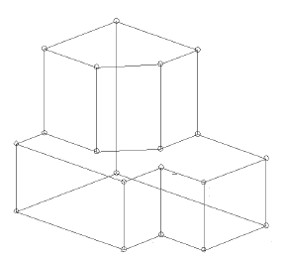
Try this

Slide 17
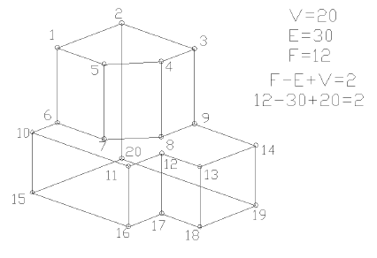
Solution

Slide 18
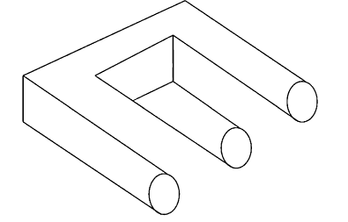
Try this

Slide 19
Boundary representation- ambiguity and uniqueness
Valid B-Reps are unambiguos
Not fully unique, but much more so than CSG
Potential difference exists in division of
  Surfaces into faces.
  Curves into edges

Slide 20
Boundary representation- advantages
Capability to construct unusual shapes that would not be possible with the available CSG→ aircraft fuselages, swing shapes
Less computational time to reconstruct the image

Slide 21
Boundary representation- disadvantages
Requires more storage
More prone to validity failure than CSG
Model display limited to planar faces and linear edges
  - complex curve and surfaces only approximated

